Slide 1
Java SE 8 Book
Chapter 1 – Kickstarter for beginner

Slide 2



1 – What is programming and programming language ?
(parent teaching their children)
(Teacher teaching their student)
(manager managing their employee)

Slide 3
1 – What is programming and programming language ?
(parent teaching their children)
(Teacher teaching their student)
Question: What is the similarity between these pictures ? (Parent, teacher, manager)
(manager managing their employee)

Slide 4
1 – What is programming and programming language ?
(parent teaching their children)
(Teacher teaching their student)
Question: What is the similarity between these pictures ? (Parent, teacher, manager)
Answer: They are all giving “instruction” to their junior
(manager managing their employee)

Slide 5
1 – What is programming and programming language ?
Thus, these actions can be called “Programming”
Parent teaching their children => Parent “programming” their children
Teacher teaching their students => Teacher “programming” their students
Manager managing their employees => Manager “programming” their employees

Slide 6
1 – What is programming and programming language ?
If they are teaching, managing using English as language => English is called “Programming language”
The set of instruction that the seniors is giving to their juniors is called “Program” or “Code”
Manager, parent, teacher are called “Programmer”
Thus, these actions can be called “Programming”
Parent teaching their children => Parent “programming” their children
Teacher teaching their students => Teacher “programming” their students
Manager managing their employees => Manager “programming” their employees

Slide 7


1 – What is programming and programming language ?
System.out.println(“Hello world”)
Hello world
The situation is the same with programmers when they are trying to “teach” the computer something

Slide 8
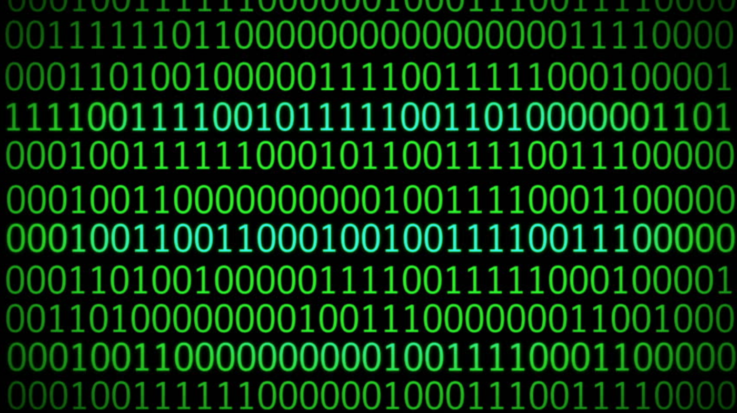
1 – What is programming and programming language ?
System.out.println(“Hello world”)
Exception found: I only understand 0 and 1 !
However, computer are just electronic devices, and the ONLY language that they understand are 0 and 1 => 0 and 1 are called “Machine Language”

Slide 9

1 – What is programming and programming language ?
The situation is the same when we going to a foreign restaurant and the waiter doesn’t understand what we are saying

